Slide 1
Watershed Rental Project
A Real Estate Case Study
A Capstone Project for the specialization Excel to MySQL: Analytic Techniques for Business taught by Duke University
File created on: 2/21/2023 6:13:41 PM

Slide 2
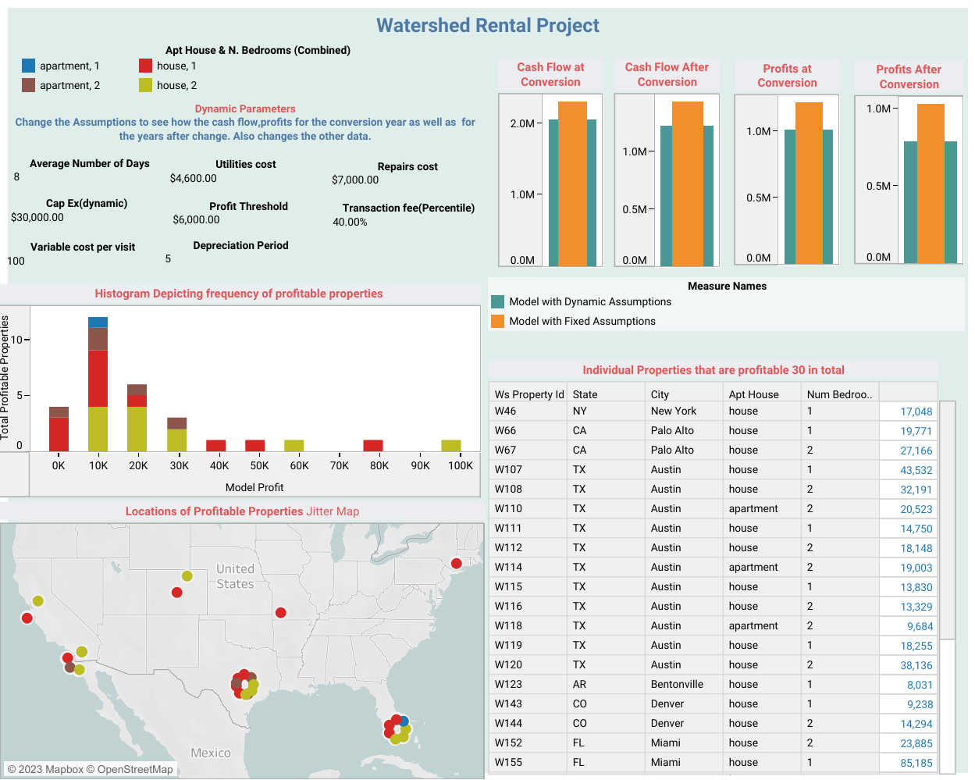

Slide 3
Given about $500,000,The Watershed should spend its money to maximize their ROI?
From the analysis, I recommend that Watershed can focus their initial investment on 16 specific rental properties that generate at least $30,000 yearly profit and are located densely in Miami, Austin, San Diego, Palo Alto, and New York.
The first stage focuses on 2 Bedroom Houses since they are the most profitable ones.
On the later stage they can be spent on converting 1 Bedroom Houses and other types of Apartments.
For the Analysis, I set all variables as unchanged except the profitability cut-off.
Therefore, investing Watershed’s initial cash on the variable that can be changed and has the most potential ROI, profitability cut-off, can help us focus on properties that are most profitable given the limited cash given, $500,000.

Slide 4
Video Link: https://drive.google.com/file/d/1f8c0PMCJe1KFwkEfyBNuEsLUFGGsxccP/view?usp=share_link
Thank You

